Slide 1
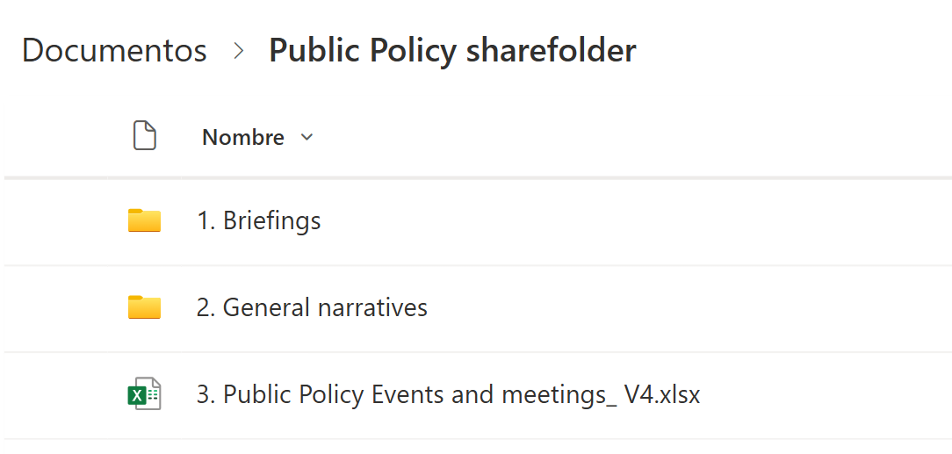
ACCESS
Click in the following:
LINK

Slide 2
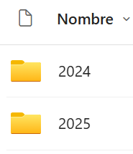
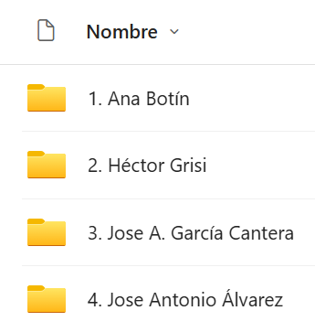
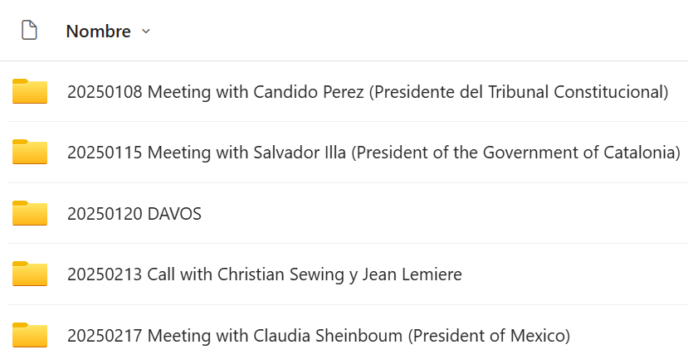
1. Briefings
…
…

Slide 3
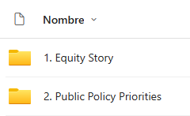

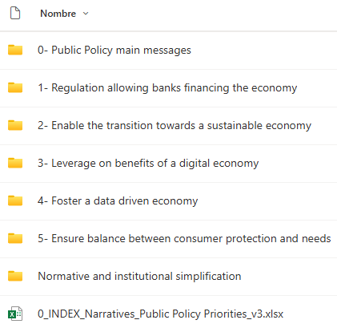
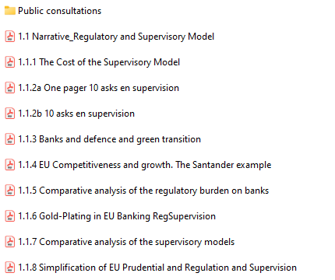
2. General Narratives

Slide 4
3. Public Policy Events and Meetings
The tracker includes the following details:
Date: Date the event took place.
Meeting/event name: Title or name of the meeting or event held.
Speaker/attendee: Name of the speaker / attendee (e.g., AB, HG, JAA, J.G. Cantera).
Location: Venue or place where the meeting was conducted.
Primary owner: Individual primarily responsible for the materials.
Secondary owner: People who assisted in preparing the materials.
Follow-up (Y/N): Indicates whether a follow-up action has occurred (e.g., letter).
Link to materials/folder: Direct link to the folder/document where materials are placed.
Meeting Outcome & Feedback: Key points discussed during the meeting and any feedback received.

